Slide 1

Introduction to Steganography
By Harith Borhan

Slide 2
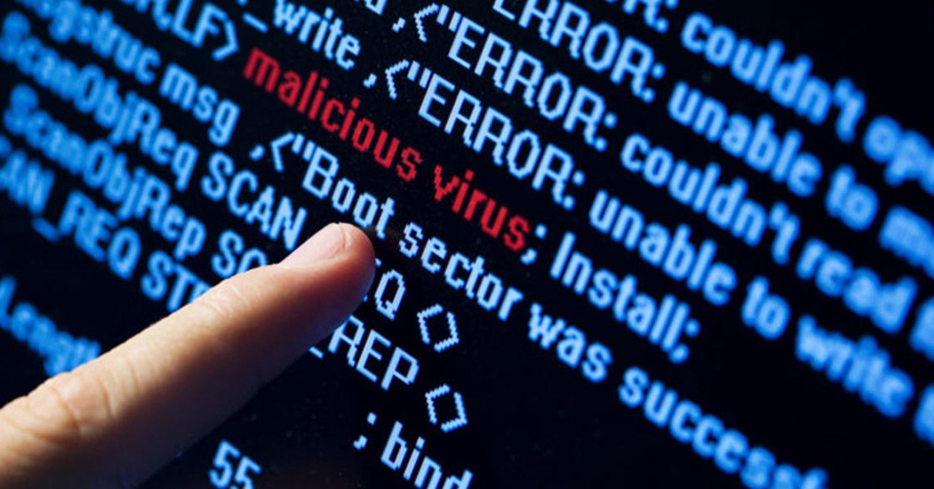
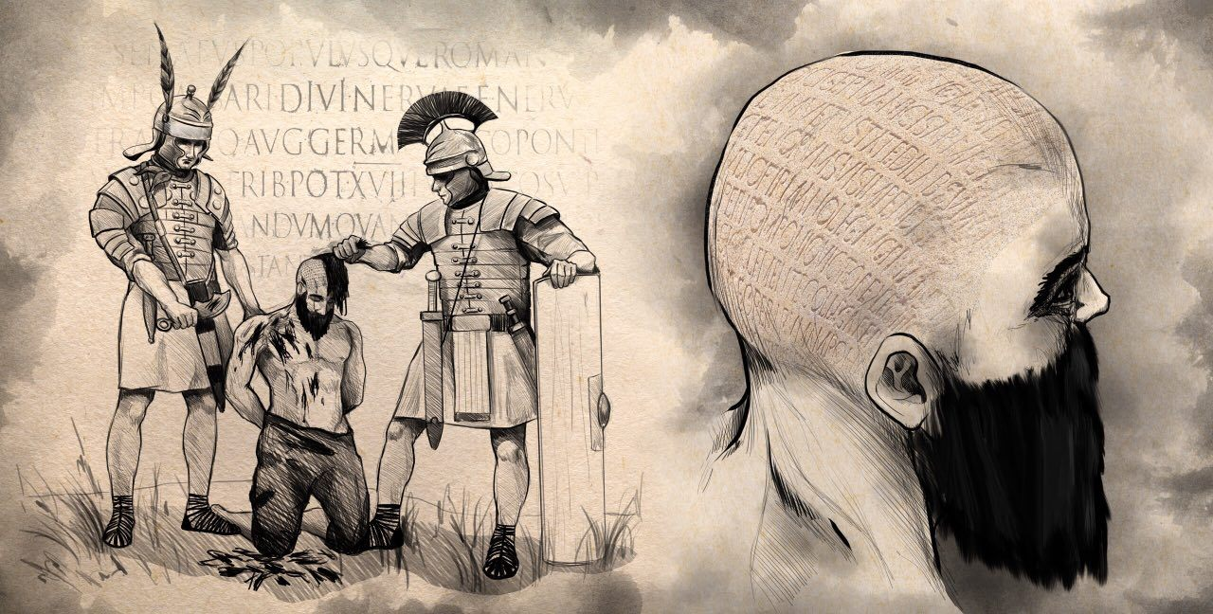
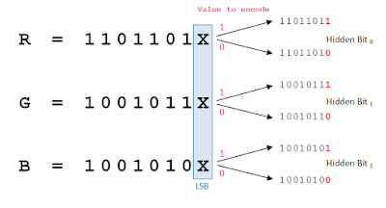
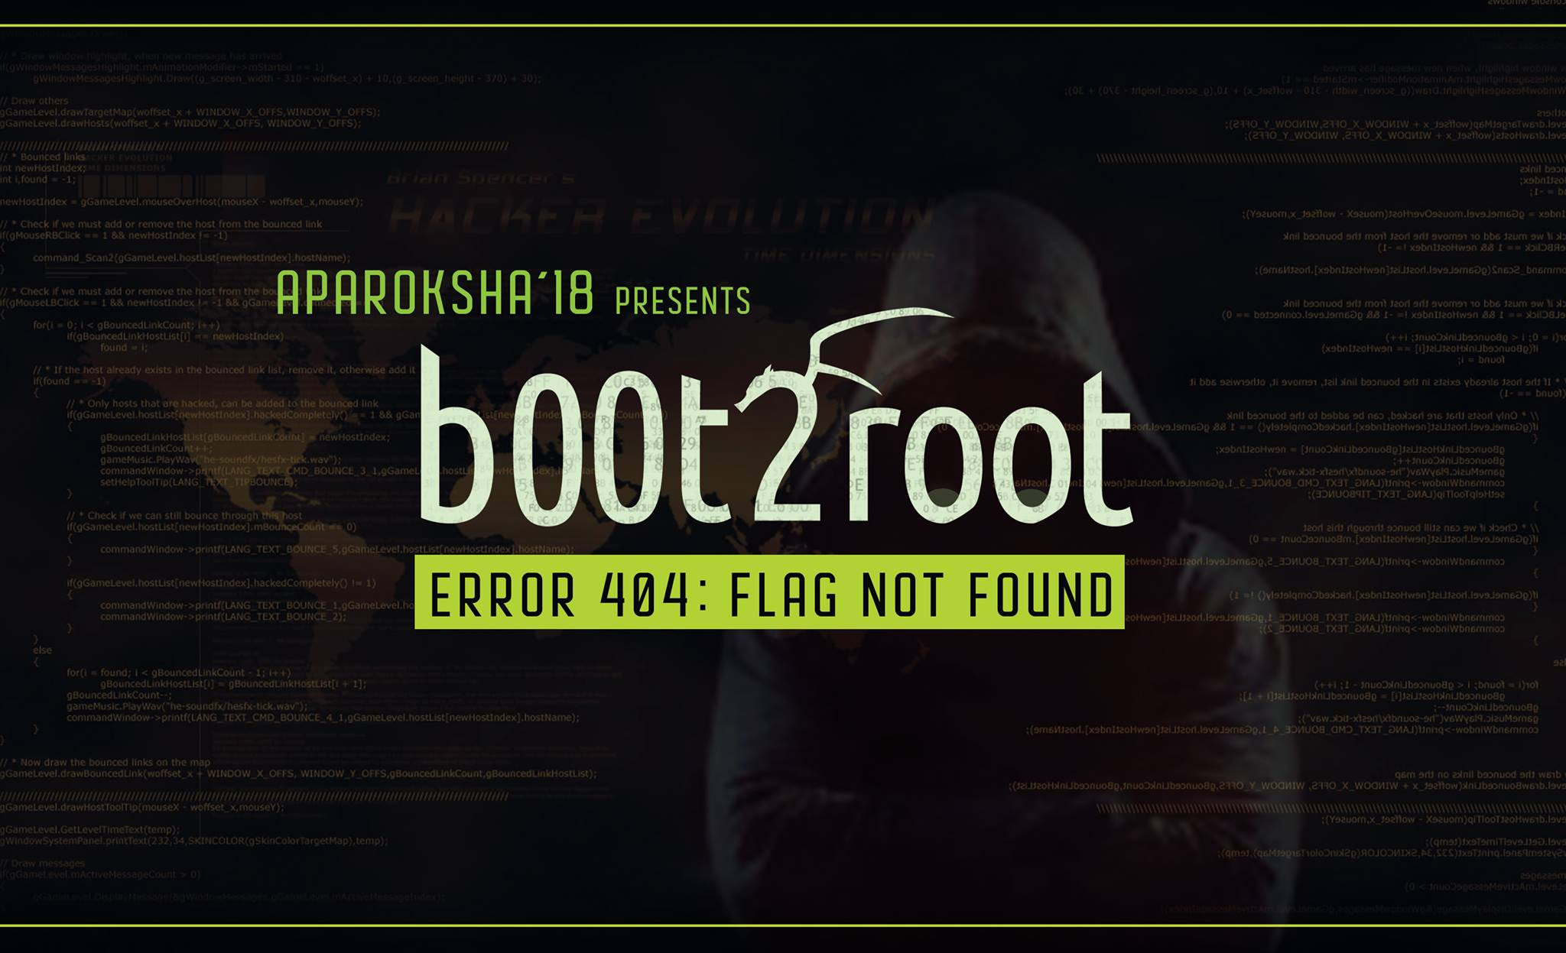
Workshop Overview
INTRODUCTION
>
METHODOLOGY
>
ANALYSIS AND DETECTION
>
APPLICATION
METHODOLOGY
APPLICATION
INTRODUCTION
ANALYSIS AND DETECTION

Slide 3
Brief overview of DIGITAL Forensics
INTRODUCTION

Slide 4
INTRODUCTION
>
METHODOLOGY
>
ANALYSIS AND DETECTION
>
APPLICATION
NETWORK ANALYSIS
MALWARE ANALYSIS
DIGITAL FORENSICS
ANTI FORENSICS
SYSTEM RECOVERY

Slide 5
history of steganography
INTRODUCTION

Slide 6
Greek History
INTRODUCTION
>
METHODOLOGY
>
ANALYSIS AND DETECTION
>
APPLICATION
Notes:
+ Steganos (covered or secret) and -graphy (writing or drawing)
+ 440BC
+ Histaeus - send slave
+ Demerstus wrote message to spartans warning of eminent invasions from Xerxes, wood of wax tablet

Slide 7

AMERICAN REVOLUTIONary WAR
INTRODUCTION
>
METHODOLOGY
>
ANALYSIS AND DETECTION
>
APPLICATION

Slide 8
Binary data manipulation with Python
METHODOLOGY

Slide 9
Quick recap
INTRODUCTION
>
METHODOLOGY
>
ANALYSIS AND DETECTION
>
APPLICATION
Read/write a file:

Slide 10
Quick recap
INTRODUCTION
>
METHODOLOGY
>
ANALYSIS AND DETECTION
>
APPLICATION
Bytes and bytearray datatypes:

Slide 11
common file structure
METHODOLOGY

Slide 12








Lossy vs Lossless
INTRODUCTION
>
METHODOLOGY
>
ANALYSIS AND DETECTION
>
APPLICATION
LOSSY
LOSSLESS

Slide 13
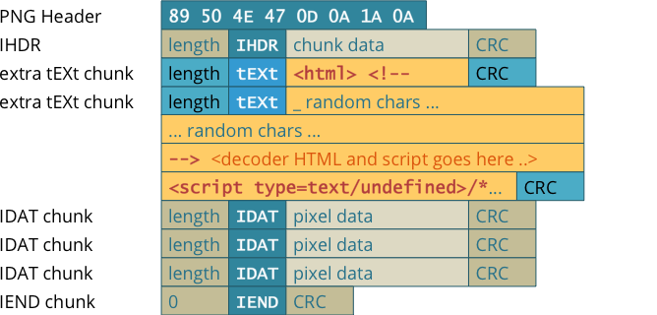
PNG FILE
INTRODUCTION
>
METHODOLOGY
>
ANALYSIS AND DETECTION
>
APPLICATION

Slide 14
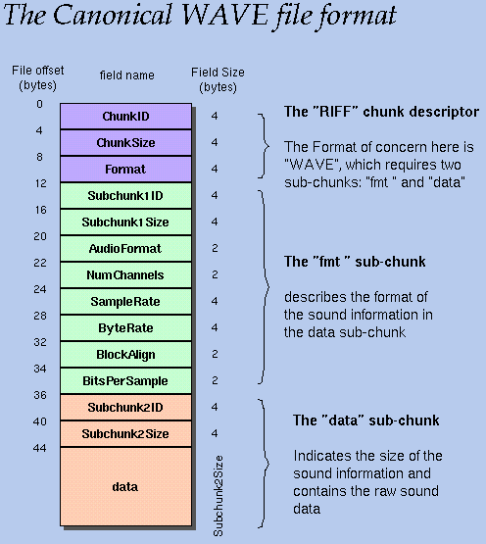
WAV FILE
INTRODUCTION
>
METHODOLOGY
>
ANALYSIS AND DETECTION
>
APPLICATION

Slide 15
Appending data to the end of file
METHODOLOGY

Slide 16
The least significant bit
METHODOLOGY

Slide 17
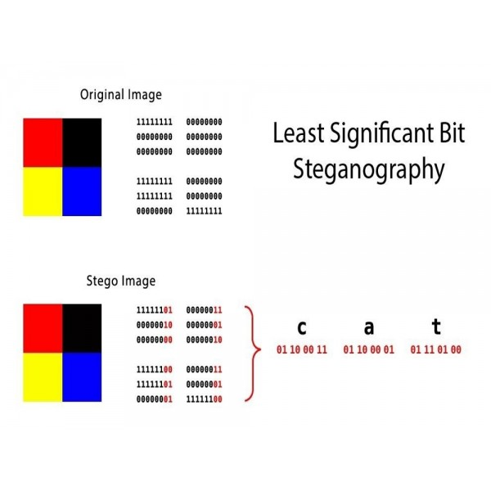
Least significant bit (LSB)
INTRODUCTION
>
METHODOLOGY
>
ANALYSIS AND DETECTION
>
APPLICATION
Changing the last bit
Insignificant change to the original data visually

Slide 18
Least significant bit (LSB)
INTRODUCTION
>
METHODOLOGY
>
ANALYSIS AND DETECTION
>
APPLICATION
DISADVANTAGES
Requires large file size to store bigger hidden data
At a certain amount of change, it is visible to detect hidden data
Will not work with lossy files, requires complex implementation or alternative methods.
Susceptible to image manipulation

Slide 19
Masking and filtering
METHODOLOGY

Slide 20
MASKING AND FILTERING
INTRODUCTION
>
METHODOLOGY
>
ANALYSIS AND DETECTION
>
APPLICATION
ADVANTAGES
Not susceptible to image manipulation or compression
Can be used on lossy file types
DISADVANTAGES
Cannot store files

Slide 21
Ways to detect steganography
ANALYSIS AND DETECTION

Slide 22
Ways to view anomalies within files
INTRODUCTION
>
METHODOLOGY
>
ANALYSIS AND DETECTION
>
APPLICATION
File size
Histogram
Binwalk and file headers

Slide 23
BUT WHY?
APPLICATION

Slide 24

OVERCOME CENSORSHIP
INTRODUCTION
>
METHODOLOGY
>
ANALYSIS AND DETECTION
>
APPLICATION
CASTLE COVERT CHANNEL

Slide 25
MALWARE STEGANOGRAPHY
INTRODUCTION
>
METHODOLOGY
>
ANALYSIS AND DETECTION
>
APPLICATION

Slide 26
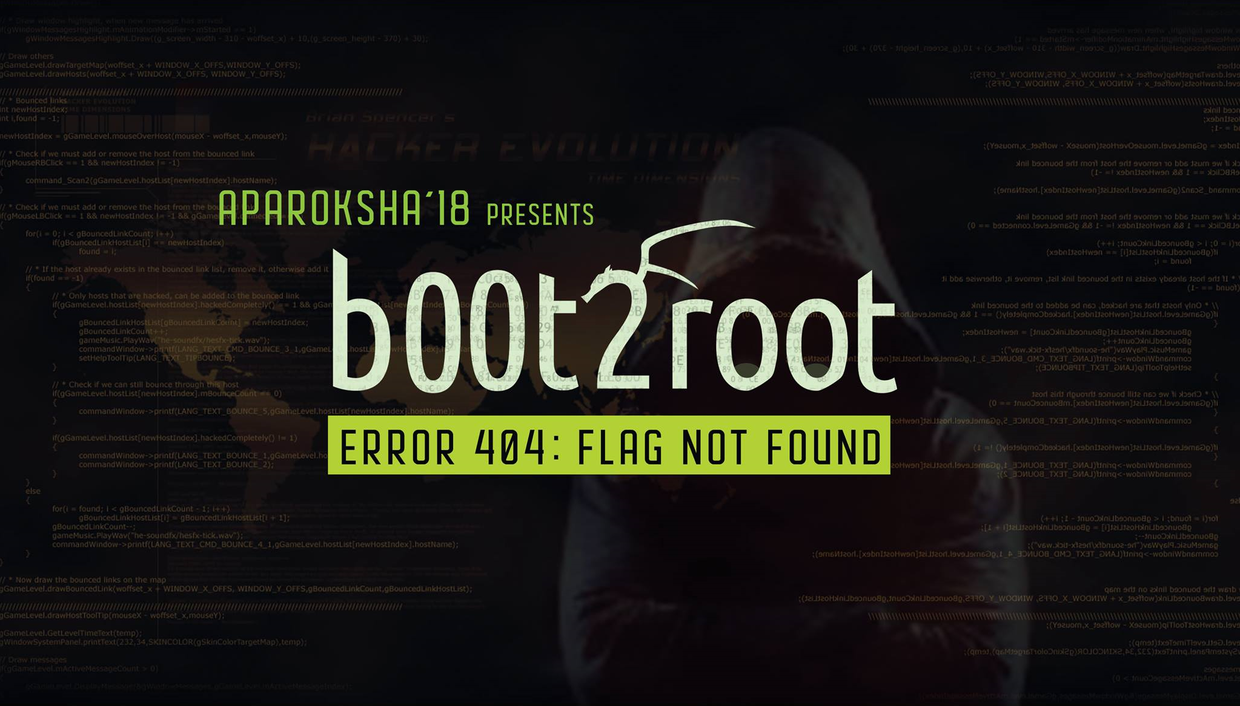
CAPTURE THE FLAG
INTRODUCTION
>
METHODOLOGY
>
ANALYSIS AND DETECTION
>
APPLICATION

Slide 27

GAME CRACKING
INTRODUCTION
>
METHODOLOGY
>
ANALYSIS AND DETECTION
>
APPLICATION

